Slide 1
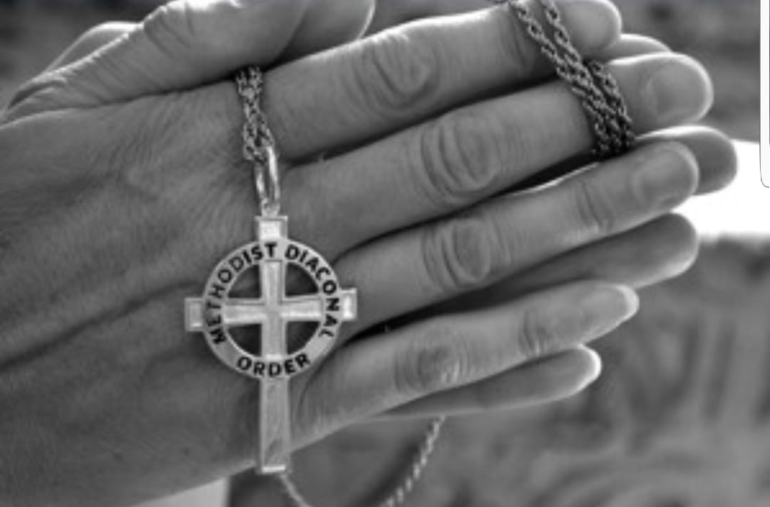
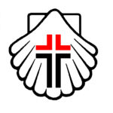
Order of Deacons Information Session
Methodist Church of Southern Africa

Slide 2
Definitions
Diaconate - the office of deacon, or a person's tenure of it.
A body of deacons collectively.
Diakonia - The Greek word diakonia means service among others, and has it roots in the Christian scriptures.
Deacon - A deacon is a member of the diaconate, an office in Christian churches that is generally associated with service of some kind, but which varies among theological and denominational traditions.

Slide 3
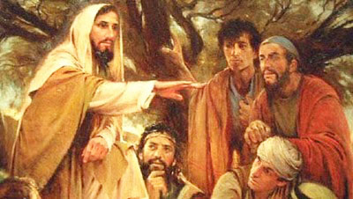
Jesus’ Servant Ministry
Compassion
Some of Jesus’ Servant Ministry
Justice
Caring
(John 13:34-35)
Caring
(John 13:34-35)
Feeding (Luke 9:10-17)
Caring
(John 13:34-35)
Feeding (Luke 9:10-17)
Healing
(Matt 4:24)
Healing
(Matt 4:24)
Reconciling
(John 4:4-26)
Reconciling
(John 4:4-26)
Reconciling
(John 4:4-26)
Advocating
(Matt 25:36-40)
Advocating
(Matt 25:36-40)
Advocating
(Matt 25:36-40)

Slide 4
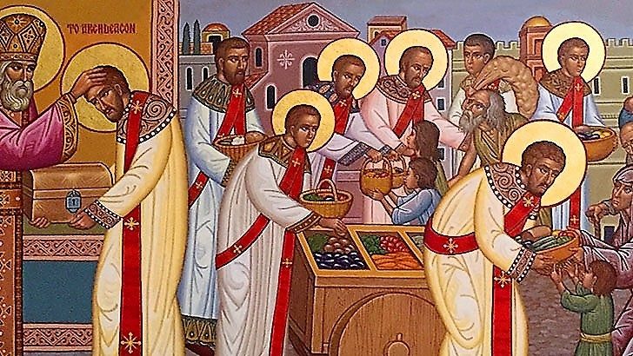
The Golden Age of Deacons
During the first three centuries, deacons flourished in numbers and leadership. Deacons had oversight of the pastoral care of the Church, were administrators of the Church’s
charities, were
assistants to the
bishops, and
were a great
symbol of Christ’s
servant ministry
to which the
church had been
called to do by
Christ himself.
* Barnett, J.M. (1995). The Diaconate: A Full and Equal Order. Trinity Press
International.

Slide 5
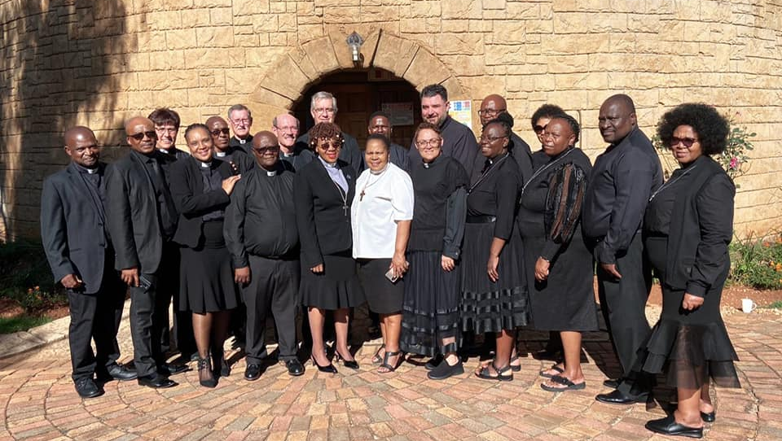
Deacons of the mcsa

Slide 6
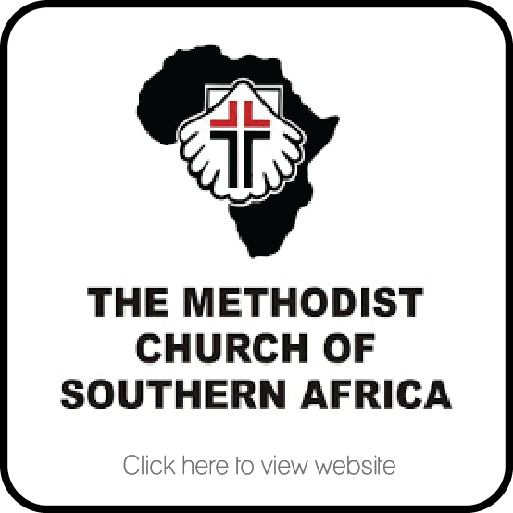
MCSA Methodist Deacons
In 1890, Rev. Applebe ordained Sister Theresa as the first Wesleyan Methodist Deaconess on the Johannesburg goldfields. In 1979 Sister Mavis Mbilini was the first black women to be ordained as a Deaconess and in 1985 she became the first black woman to be ordained to the Ministry of the Word and Sacraments in the MCSA.
When men were admitted to the Order in
the mid-nineties the name changed to the
current Methodist Order of Deacons - MOD.
The first Deacon from Swaziland was ordained in 2011, with another since then and we have Deacons in Mozambique, and Botswana and all over South Africa.

Slide 7
MCSA Methodist Deacons Vision
The vision of the Methodist Order of Deacons is ‘To share Christ’s love through service and to help the church respond to the needs of the wider community.’ (Methodist Book of Order 13.1)

Slide 8
MCSA Deacons Role
As deacons, we serve the MCSA as Ministers of Word and Service. We do so by applying skills, talents, experience and insights we have accumulated that have shaped us for ministry.
We aim to positively impact the Church’s ability to be Missional. Our guidance is towards practical theology (hands-on, living the Gospel injunction to love God and one another) that results in the development of strategies and implementation of activities that are constantly evaluated and assessed to maximise impact and transformation within our communities. We avail ourselves to serve on task teams, committees, and work groups that formulate, promote and implement mission strategies.

Slide 9
Deaconate an Ordained Ministry
Ordination is a visible and outward sign of the sacred trust of clergy leadership. It is a gift of God, given to Christ’s church through the power of the Holy Spirit. Ordination is a holy act of the church universal that empowers clergy, who manifest an inward and spiritual grace, to represent the divine initiative at work
in the community through the life
of apostolic ministry.

Slide 10
Called to Leadership:
Ministry of
Service
Community Projects
- Homeless / Vulnerable
- Prison Ministry
Ministry of
Word
Preaching & Teaching
Worship Leader
Young adult Ministry
- Children Ministry
Examples
Examples
1 Peter 4:10 ¹⁰Each of you should use whatever gift you have received to
serve others, as faithful stewards of God's grace in its various forms.
Ministry of Compassion
Counselor
- Psychosocial Support
Bereavement / Grief
Ministry of
Justice
Social Work
Disability Ministry
Advocates
Examples
Examples

Slide 11
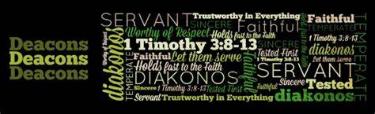
The work of a Deacon
Some Common Responsibilities
In teaching and proclaiming of the Word
In contributing to worship and in assisting the
Presbyter in the missional aspects of the local church
In forming and nurturing disciples
In conducting marriages and burying the dead
In embodying the church’s mission to the world and
In leading congregations in interpreting the needs, concerns and hopes of the world.

Slide 12
MCSA Deacons
CONNECTIONAL
Bridges the church with the world and vice versa
IDENTITY
Has a “deacon’s heart” (a heart for serving) and is called to a lifetime vocation
MISSIONAL
Ministry of service is to lead; Faithful to service & leadership of the church
ORDAINED to
Word
Service
Compassion
Justice
CALLED & SENT
MCSA leader representing Christ; leads in servanthood
EXAMINED & EQUIPPED
Candidacy
Academics
Rule of Life
Typically Specializes

Slide 13
Deacons are Connectional
Bridging the Church with the World
Share Christ
with the world
Advocate for
the marginalized
Lead with Presbyters
Outreach
ministries
Lead
missions
Prepare disciples (hearing their stories)
Hold conversations
for change
Support church leaders in
ministry
Share the
world’s concerns with the church

Slide 14

MCSA Methodist Clergy
EQUAL ORDERS – both are set apart for ordained ministry
PRESBYTER
Word
Service
Sacrament
Order
DEACONS
Word
Service
Compassion
Justice
PARTNERS

Slide 15
Order of Deacons
Purpose of an Order Convocation
Provide for regular gatherings of ordained deacons for continuing formation in relationship to Jesus Christ through such experiences as Bible study, study issues facing the church and society, and theological exploration in vocational identity and leadership;
Assist in plans for individual study and retreat experiences;
Develop a bond of unity, and common commitment to the mission and ministry of the MCSA and Synod;
Enable the creation of relationships that allow mutual support and trust;
Hold accountable all members of the order in fulfilling of these purposes.
Work with and alongside Evangelist and Bible women
All of the functions of the order(s) shall be fulfilled in cooperation and coordination with EMMU and do not replace the normal supervisory processes of other entities.
The bishop shall convene and provide continuing spiritual leadership for the order, with the support and assistance of the Warden of the Diaconal Order

Slide 16
Ministry Distinctions
Clergy Appointments
 | Presbyter (Order) | Deacon (Order) | Local Preacher (Fellowship)
Common Ministry | Word & Service | Word & Service | Word & Service
Distinctive Ministry | Sacrament Order | Justice Compassion | Witness Mission
Biblical Role | Apostolic | Diakonia | Exhortation
Role in Connecting the Church | Church & Denomination | Church & World | Church & Individual

Slide 17


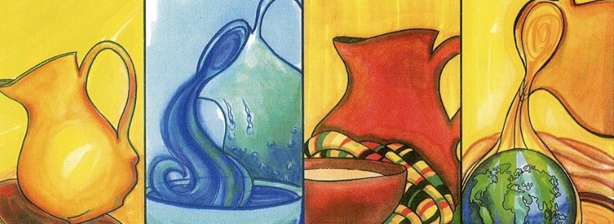
Connections & Networking
DIAKONIA World Federation
reflects on the nature and task of diakonia in the biblical context
links and gathers those who are engaged in diaconal work worldwide
encourages, supports and empowers the development of groups doing diaconal work
is a living experience of ecumenical relationships
Membership consists of associations, organizations and communities of deaconesses, deacons, diaconal brothers and sisters, diaconal ministers and other church workers
furthers the understanding of the diaconate
provides a network of mutual relationships crossing church traditions and cultural boundaries
www.diakonia-world.org

Slide 18

Contact
Deacon Charmain Fourie
Charmain.Fourie@willows.org.za
082 416 6946

